Slide 1


Slide 2
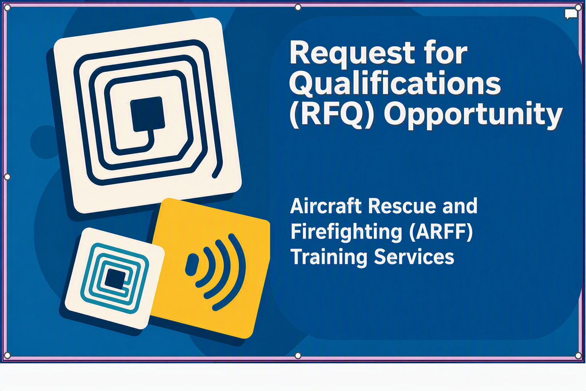

Slide 3

Procurement Inclusivity
Disclaimer
ℹ️ Important Notice
This presentation provides a summary of the Request for Qualification (RFQ) specifications and requirements.
It does not cover every required element in detail.
Nothing presented here overrides or replaces the official RFQ documentation.
☑️ Respondent Responsibility
Ensure your Qualification documents are complete and accurate.
Follow all information and requirements outlined in the RFQ.
💬Questions & Answers
No live Q&A during this meeting.
All questions must be submitted in writing via Bonfire/Euna Procurement – Vendor Discussions.

Slide 4

Agenda
Welcome / Introductions
Procurement Overview and Timeline
Technical Specifications – Scope of Work
Evaluation Criteria
Submittal A – Administrative Requirements
Submittal B – Experience
Submittal C – Written/Technical Qualification
Reminders

Slide 5
Procurement Inclusivity
Procurement Overview
Los Angeles World Airports (LAWA) is issuing this Request for Qualifications (“RFQ”) to solicit Statements of Qualifications (“SOQ”) from qualified firms (“Respondents”) to prequalify for an Airport Bench Contract (ABC) pool of on-call services for comprehensive FAA-recognized Aircraft Rescue and Firefighting (“ARFF”) training providers
LAWA is seeking Respondents capable of delivering 14 Code of Federal Regulations section 139.319-compliant annual certification, recurrent training, and live fire drills for LAFD ARFF personnel services
The term for this request will be three (3) years, plus two (2) one-year renewal options, with a total funding authority value of $700,000

Slide 6
Procurement Inclusivity
Procurement Timeline
RFQ Released / Issued | Thursday, August 6, 2026 4:00 PM, Pacific Time
Pre-Proposal Conference | Thursday, August 13, 2026 10:00 AM, Pacific Time
Initial Deadline to Submit Questions | Thursday, August 27, 2026 4:00 PM, Pacific Time
Qualification Due Date (Deadline to Submit) | Thursday, September 24, 2026 4:00 PM, Pacific Time
Interviews | Thursday, November 5, 2026* 2:00 PM, Pacific Time*
Notice of Intent to Award | Thursday, November 19, 2026* 4:00 PM, Pacific Time*
*Tentative Date/Time

Slide 7


Slide 8
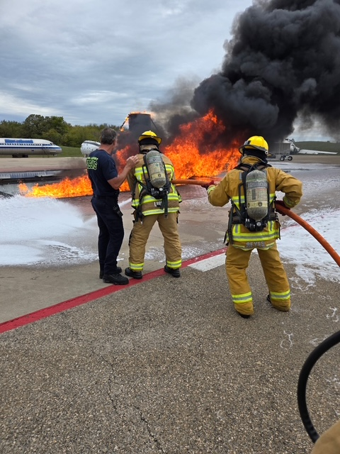
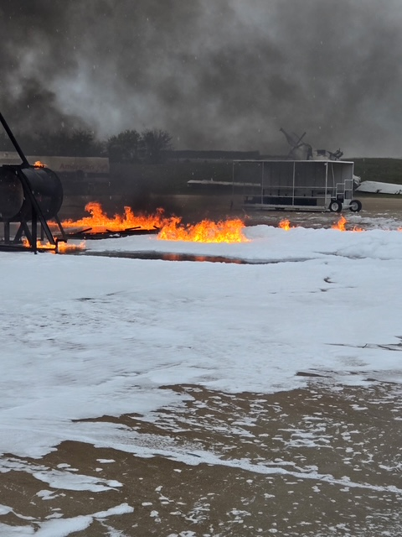
Conveyance Monitoring @ LAX
Technical Specifications – ARFF Training for LAX
Key Points
Currently 91 members are fully certified members
Currently 12 members going through certification process (all 12 members had to travel outside of California to get the initial 40-hour Aircraft Rescue and FireFighting (ARFF) training)
2
3

Slide 9
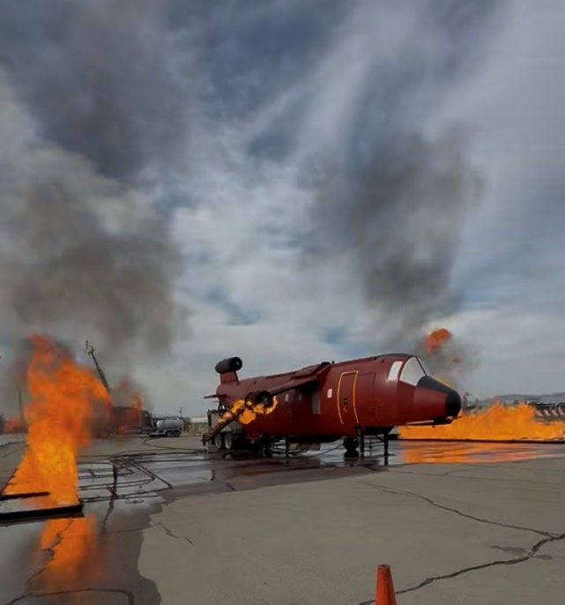
Technical Specifications – ARFF Training for LAX
Live-Fire Drills:
Certified members must participate in at least one live-fire exercise every 12 months to maintain proficiency and remain compliant with ARFF training requirements.
During these exercises, members receive hands-on training involving multiple live-fire scenarios, including engine fires, wheel assembly and brake fires, baggage compartment and fuselage fires, and fuel spill (pool fire) incidents. The training also reinforces the proper procedures for safely shutting down an aircraft.
2
3

Slide 10
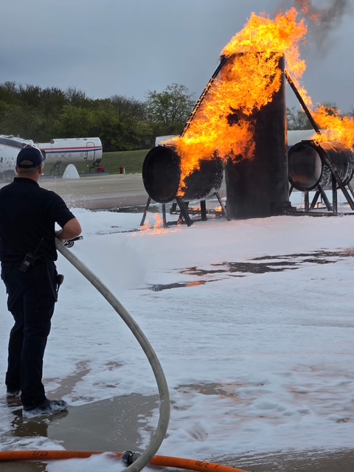
Technical Specifications – ARFF Training for LAX
Identified Needs:
We would like to see additional training opportunities utilizing our High Reach Extendable Turrets (HRET). Because this training must currently be conducted off-site, members are unable to regularly train on the apparatus they operate daily.
We would also like to have outside fire stations than would normally respond to an aircraft emergency at LAX participate in multi-compnay drill with ARFF personnel.
2
3

Slide 11
Procurement Inclusivity
Evaluation Criteria
Criteria | Reference | Weight
Administrative Documents (Mandatory) | Submittal A | Pass/Fail
Experience (Mandatory) | Submittal B | 30
Technical SOQ | Submittal C | 40
Interview (if shortlisted) |  | 30
 | TOTAL | 100

Slide 12


Slide 13


Submittal A - Administrative Requirements
The Administrative Requirements are a set of policies, forms, and procedures that contractors must comply with when working for LAWA and the City of Los Angeles. These requirements are mandated by one of three authorities: the Los Angeles City Charter, the Los Angeles Municipal Code, or the Los Angeles Administrative Code.
Submitting an incomplete form or failing to submit a required form may deem bids/Qualifications as non-responsive and could result in their rejection.
Administrative Requirements Video Link below
Administrative Requirements | Los Angeles World Airports
https://www.lawa.org/lawa-businesses/lawa-administrative-requirements

Slide 14
Submittal A - Selected Contractor Requirements
If you are awarded the contract and prior to execution of the contract:
Insurance
Business Tax Registration Certificate (BTRC)
The following requirements do not require the completion of forms but may be incorporated as provisions of the contract:
Affirmative Action
Child Support Obligations
Living Wage Ordinance
Assignment of Anti-Trust Claims

Slide 15
Submittal A - Administrative Requirements Overview
Submit ALL required forms.
1
Use the forms provided in the RFQ package.
2
Read the instructions carefully and thoroughly to complete each required form (SIGN & DATE).
3
Ensure the firm name is used consistently throughout the forms.
4
If you have any technical problems with Bonfire, please contact Support@GoBonfire.com for assistance.

Slide 16
Service Categories – Respond to ANY or ALL
Category | Delivery Model | Facility Basis | Primary Use Case
A — Fixed Facility | LAWA personnel travel to provider's facility | FAA-recognized fixed training facility (FAA ARFF Training Facility Addendum) | Planned annual/biennial recurrent training; full-scenario programming for larger cohorts
B — On-Site / Mobile | Provider deploys to LAWA airports or designated training sites | FAA-recognized mobile ARFF training authorization (AC 150/5210-17C) | Surge capacity, corrective action response, initial training for new personnel, schedule-constrained needs

Slide 17

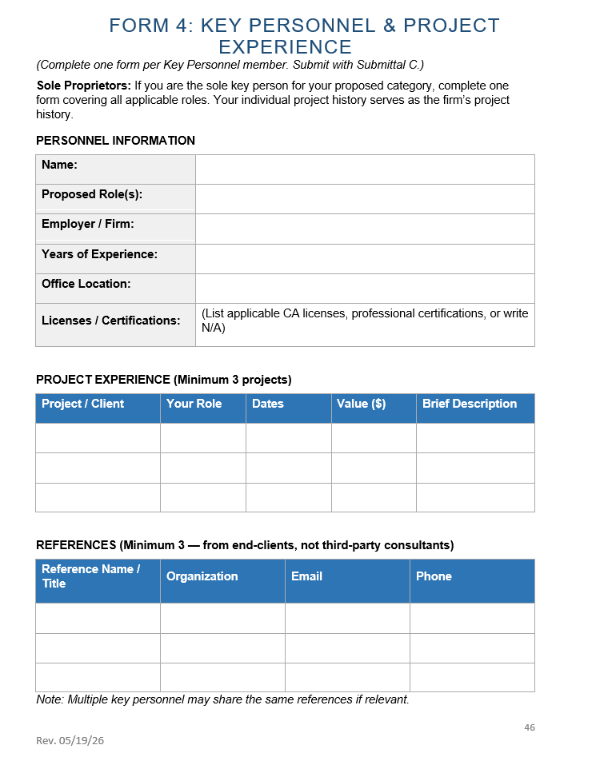
Submittal B – Experience
Respondents must demonstrate (via Form 4) – Key Personnel & Project Experience and the required narrative, that their organization and proposed personnel satisfy the following threshold qualifications.
“Desired Qualifications” are NOT mandatory for pre-qualification, but will be considered in scoring

Slide 18
Submittal B – Experience
Minimum Qualifications for Part 139 Compliance
  5+ years ARFF training experience
  3+ years Key Personnel experience
  3 recent comparable projects
  Active FAA Category A/B recognition
  Multi-year contract capacity
  Active airport/SIDA experience

Slide 19
Submittal B – Experience
Desired Experience
NOT mandatory for pre-qualification, but will be considered in scoring
  Large-hub airport experience
  Part 139 inspection support
  Advanced ARFF training methods
  Multi-year recurrent programs
  AIP grant/procurement familiarity

Slide 20

Submittal C – Written / Technical Statement of Qualification
The Written/Technical SOQ has two (2) separate parts, each with a maximum page limit requirement. The Respondent shall title this submittal, “Submittal C”.
All SOQs must include a cover letter, cover page, and table of contents with clear titles and labels for both parts of the Written/Technical SOQ.
A separate Written/Technical SOQ must be submitted for each category proposed. Each submittal must be clearly titled to reflect its respective category — e.g., “Category A — Fixed Facility” or “Category B — On-Site/Mobile.” Submittals that do not clearly identify the applicable category will not be evaluated.
Submitting an incomplete form or failing to submit a required form could deem bids/Qualifications as non-responsive and could result in their rejection.

Slide 21
Submittal C – Written / Technical Qualification
Part 1
  Qualifications and Experience
  (10-Page Limit – excluding resumes)
  Organizational Qualifications
    Experience & Qualifications
    FAA Recognition
    Compliance Program
    Operational Capacity
    Airport/Public-Sector Experience
  Past Project Examples
    Minimum of 3 examples
  Key Personnel

Slide 22
Submittal C – Written / Technical Qualification
Part 2
  Approach and Methodology
  (10-Page Limit)
  Must address the following:
  Understanding of Requirements
  Risk and Challenge Identification
  Methods, Tools, and Technical Approach
  Training Cycle Planning and Schedule Management
  Airport Environment and Operational Coordination
  Task Order Development and Response Capability
  Regulatory Compliance and FAA Audit Readiness
  Client Management and Communication Protocol
  Concurrent Task Order and Surge Capacity

Slide 23
Reminders
Submit your questions in writing via Bonfire’s “Vendor Discussions” tab, and SSD will address them formally. Rely only on the information in the RFQ or information changed by written addenda.
1
You will be notified of new or updated information, including any addenda, via the “Public Notices” tab in Bonfire.
2
Check the “Public Notices” tab often to view updated information, especially to any Questions and Responses/Answers.
3
Submit your bid before the closing date and time.
4
Upload all completed required documents to their associated file name in Bonfire
5

Slide 24


